Slide 1
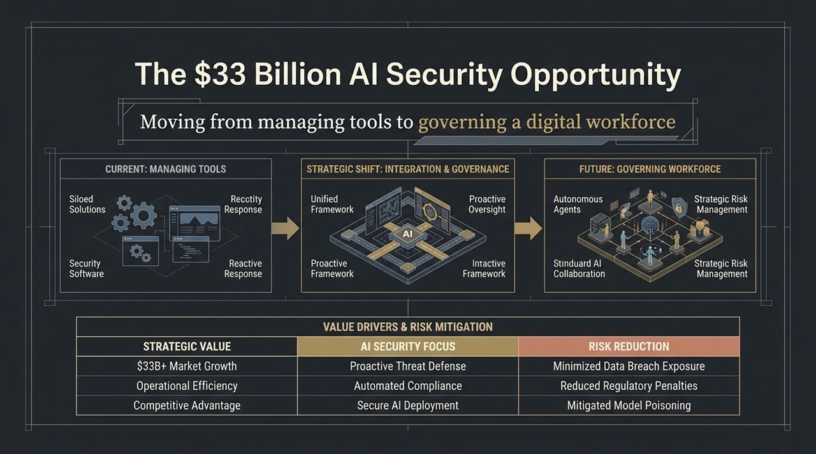
Notes:
Opening / Hook: Good morning, everyone. Today, we are standing at the threshold of one of the largest structural shifts in cybersecurity and enterprise operations over the past decade.
Core Concept: As shown on the slide, the AI market isn't just about buildout and model training anymore—it represents a $33 Billion AI Security Opportunity. The fundamental shift taking place is moving from managing security tools to governing an entire autonomous digital workforce.
Current vs. Future State:
Current State: We operate with siloed security software, reactive responses, and fragmented controls.
Future State: We are migrating toward a unified, proactive governance framework built around autonomous agents, standard AI collaboration, and strategic risk management.
Strategic Value Drivers: Notice the table on the right. Moving to proactive AI security drives three tangible outcomes: proactive threat defense, automated compliance, and secure AI deployment. The risk reduction isn't marginal—it dramatically minimizes data breach exposure, lowers regulatory penalties, and mitigates model poisoning.
Transition to Slide 2: To understand why this security market is exploding, let’s first look at how the role of AI inside our enterprises has fundamentally transformed.
https://www.youtube.com/watch?v=pWlfN0_fVmg

Slide 2
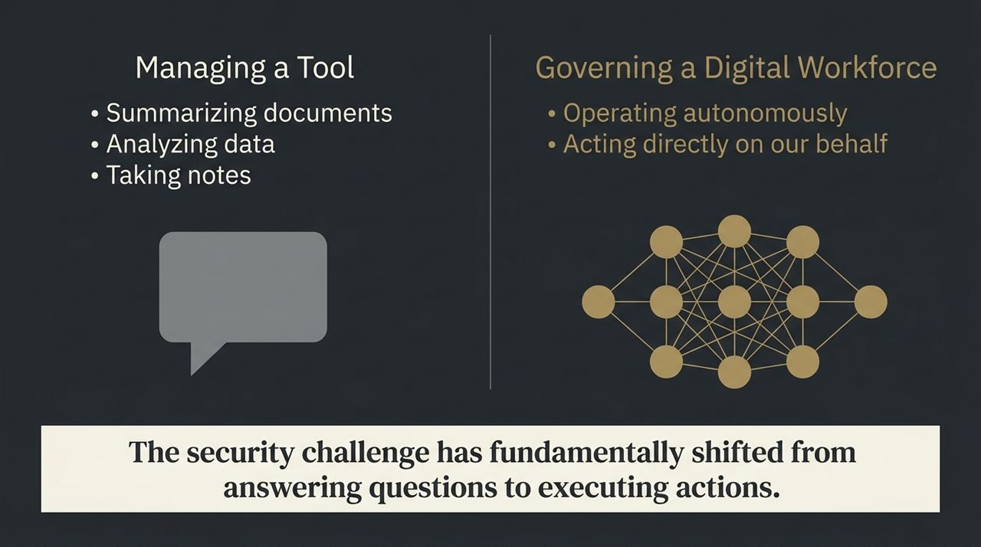
Notes:
Talking Points: Up until recently, our interaction with AI has been tool-centric. We asked AI tools to perform narrow tasks: summarize documents, analyze structured datasets, or take notes during video conferences.
The Paradigm Shift: However, we are now entering the era of Agentic AI. AI tools are transitioning into a Digital Workforce. They operate autonomously and act directly on our behalf across various corporate applications.
Key Takeaway: As emphasized in the bottom callout: The security challenge has fundamentally shifted from answering questions to executing actions. When a system shifts from passively generating text to triggering API calls, executing workflows, and modifying databases, standard 'tool management' security models completely fall apart.
Transition to Slide 3: To grasp the sheer scale of this challenge, let's examine the mathematical explosion of identities entering our network environments.

Slide 3
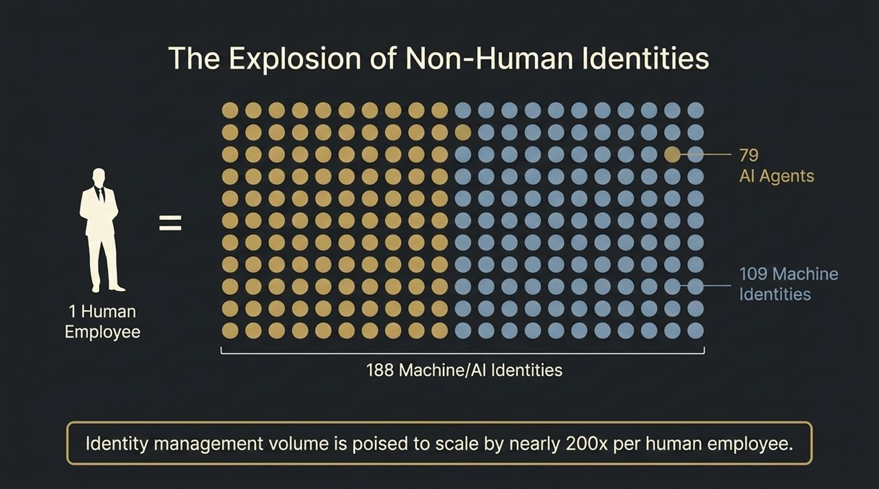
Notes:
Data Point Analysis: Look at the visual ratio on this slide. For every single 1 Human Employee added to an enterprise today, security architectures will soon have to manage 188 Non-Human Machine/AI Identities.
Breakdown: That ratio consists of 79 Autonomous AI Agents and 109 Machine Identities per human worker.
Contextual Framing: Historically, identity management was built around the human headcount—onboarding, offboarding, and role-based privilege checks. Now, identity volume is scaling by nearly 200x per human employee.
Speaker Caution: Imagine a company with 10,000 employees. You are no longer managing 10,000 identities; you are governing nearly 2 million active, non-human actors moving through your infrastructure every single day.
Transition to Slide 4: Before we even introduce these autonomous agents, let's look at the baseline vulnerability of our current identity defenses.

Slide 4
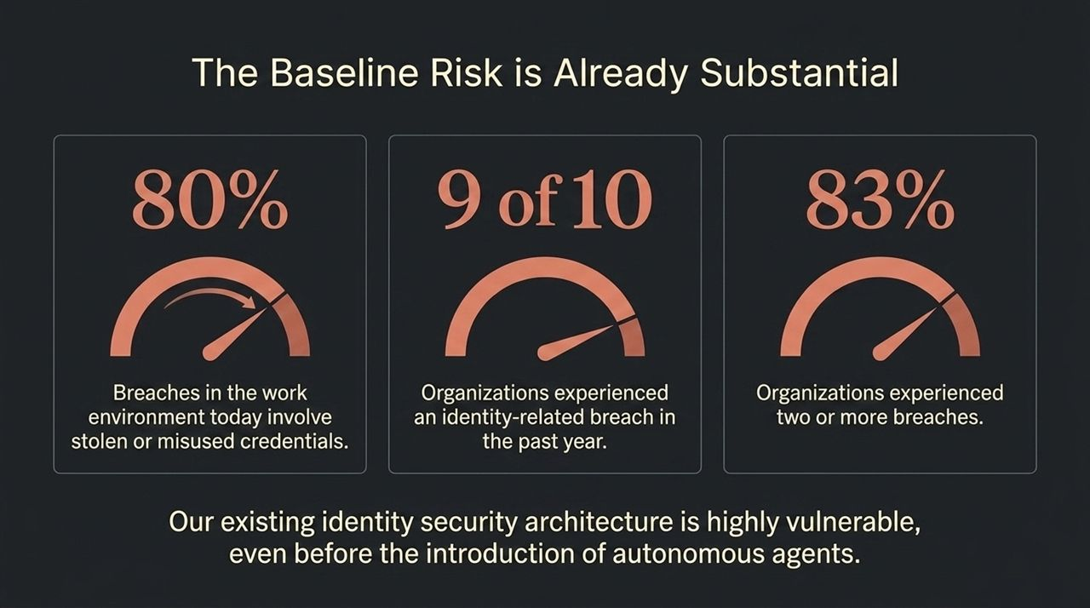
Notes:
Industry Data & Risk Assessment: We must be brutally honest about the current security environment: Our identity baseline is already deeply fragile.
Key Metrics:
80% of all data breaches in enterprise environments today involve stolen or misused credentials.
9 out of 10 organizations experienced at least one identity-related breach over the past 12 months.
83% of organizations experienced two or more breaches in the same period.
Core Conclusion: Existing identity security architectures are struggling to defend basic human login credentials. Injecting millions of high-velocity AI agents into a system that is already failing 90% of the time creates an existential operational risk.
Transition to Slide 5: When you combine this fragile baseline with autonomous agents operating at scale, you get what we call the AI Vulnerability Multiplier.

Slide 5
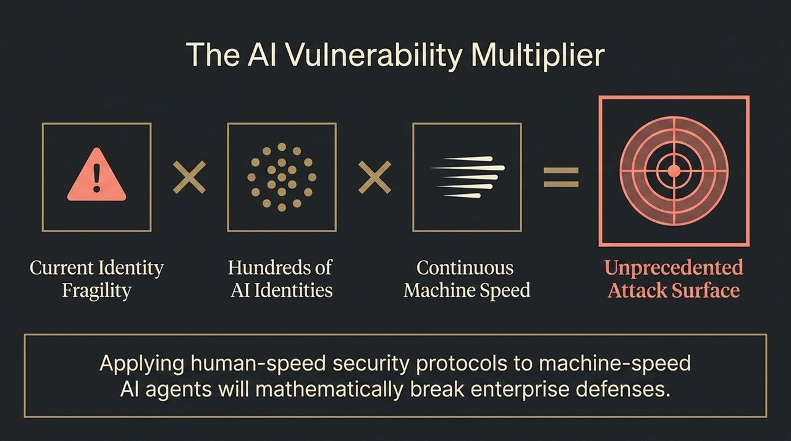
Notes:
Mathematical Formula Breakdown: This slide summarizes the core threat formula every CISOs and CIO must understand:
$$\text{Current} \text{Identity} \text{Fragility}×\text{Hundreds} \text{of} \text{AI} \text{Identities}×\text{Continuous} \text{Machine} \text{Speed}=\text{Unprecedented} \text{Attack} \text{Surface}$$
In-Depth Explanation: If you take a fragile identity setup and multiply it by hundreds of non-human identities operating continuously at sub-second machine speeds, human-speed governance breaks down entirely.
Key Warning: Applying human-speed security protocols to machine-speed AI agents will mathematically break enterprise defenses. You cannot rely on manual approvals, weekly audit logs, or human SOC analysts to monitor actions happening in milliseconds.
Transition to Slide 6: Let's contrast traditional identity models with what agentic identity actually requires.

Slide 6
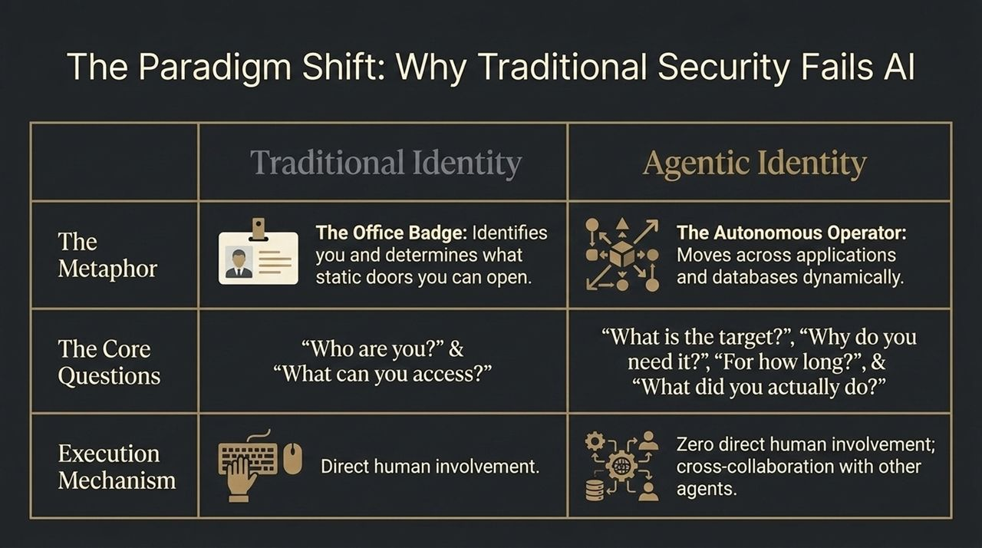
Notes:
The Badge Metaphor: Think of traditional identity security like an office ID badge. It answers two static questions: 'Who are you?' and 'What doors can you open?' Once you pass the turnstile, you have implicit trust inside that area.
The Agentic Reality: An AI Agent is an Autonomous Operator. It doesn't stand at a door; it moves across disparate databases, calls external APIs, and interacts dynamically with other agents without direct human oversight.
New Security Questions: Agentic identity requires answering four completely new questions:
What is the exact target?
Why do you need it right now (Intent)?
For how long (Duration)?
What did you actually do while you had access (Audit)?
Transition to Slide 7: These four questions form the foundation of our next framework: The 4 Pillars of Governing Agentic Identity.

Slide 7
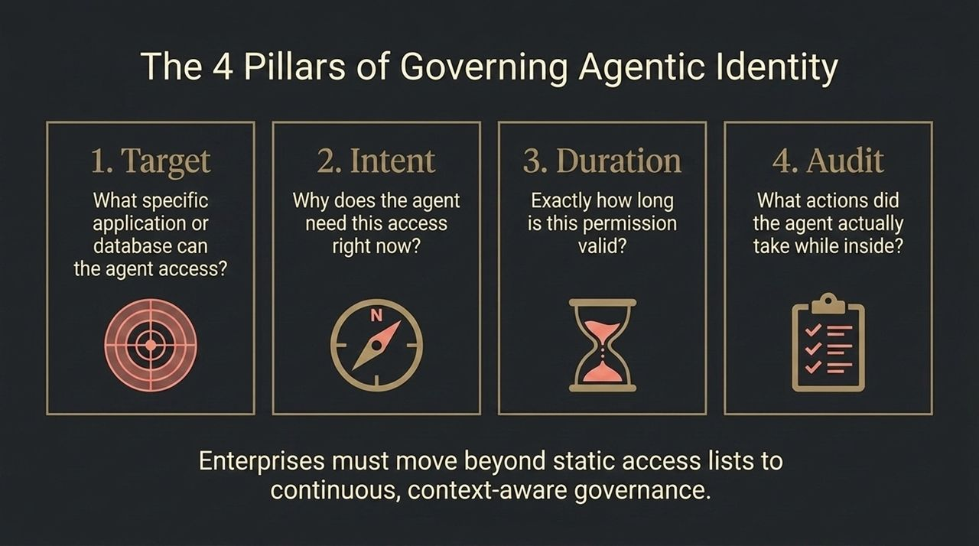
Notes:
Framework Walkthrough: To govern autonomous agents effectively, enterprise security must center around four core pillars:
Target: What specific application, database, or API endpoint is the agent attempting to access?
Intent: Why does the agent require this access right now? What is the business context?
Duration: Exactly how long is this permission valid? Minutes? Seconds?
Audit: What actions did the agent actually execute during its session?
Strategic Shift: Enterprises must transition from static, access-control lists to continuous, context-aware runtime governance. If an agent's task changes mid-execution, its access scope must automatically adjust.
Transition to Slide 8: How do we enforce this technically? Through an architectural model called Zero Standing Privilege.

Slide 8
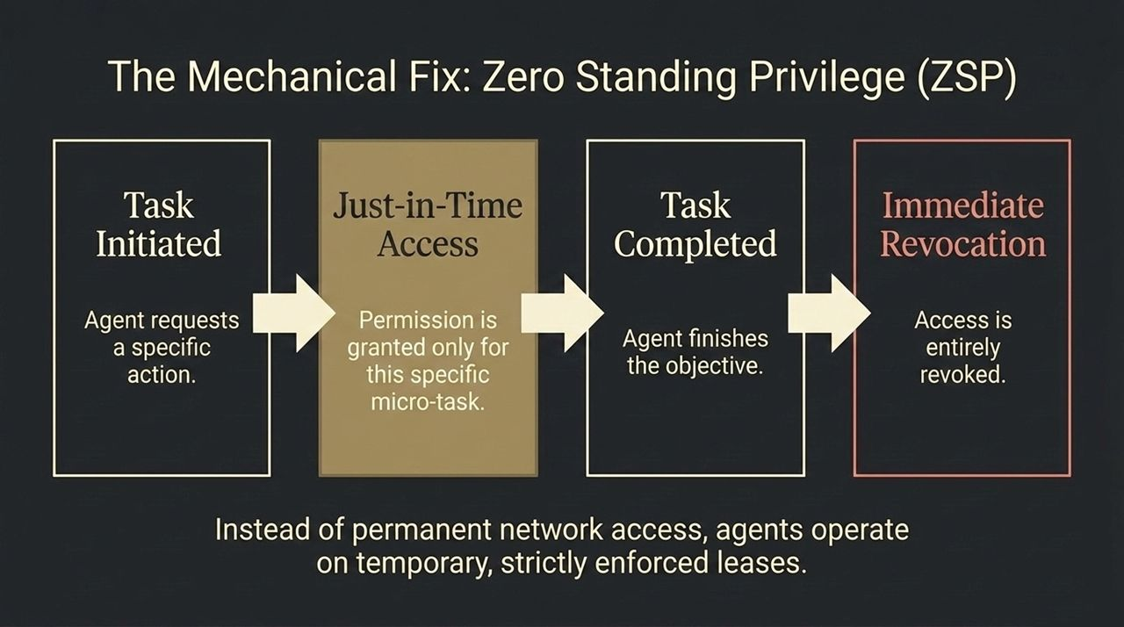
Notes:
Concept Explanation: In traditional IT, admins and service accounts are granted 'standing privileges'—permanent access rights that persist indefinitely. In an agentic world, standing privilege is a major security hazard.
Workflow Breakdown:
Step 1 (Task Initiated): An agent requests permission to perform a specific action.
Step 2 (Just-In-Time Access): Permission is granted only for that micro-task and for a strictly bounded timeframe.
Step 3 (Immediate Revocation): The instant the objective is completed, access is completely revoked.
Core Principle: Instead of permanent network access, agents operate on temporary, strictly enforced leases. If an agent is compromised, the attacker gains no persistent access.
Transition to Slide 9: While Zero Standing Privilege is the ideal solution, there is a major implementation gap in today's enterprise environments.

Slide 9
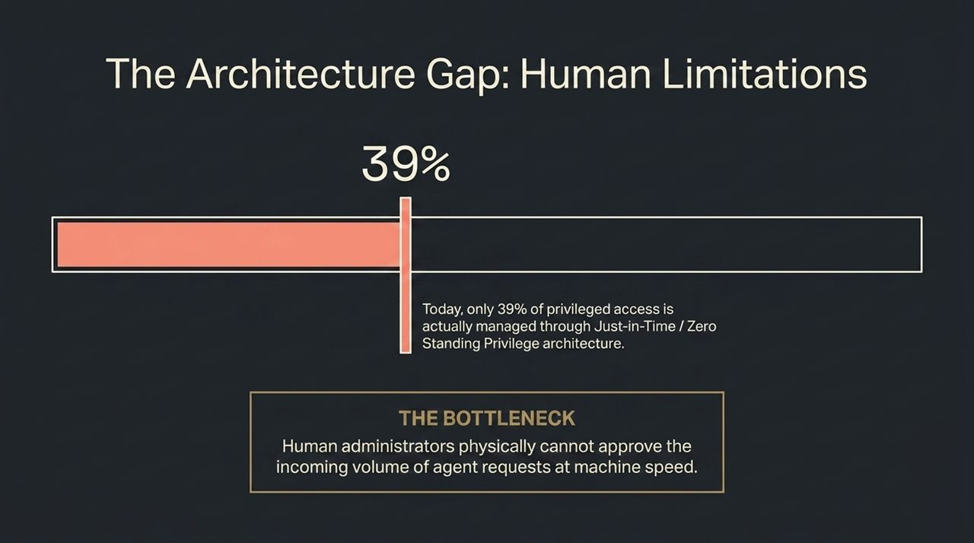
Notes:
The Reality Check: Despite the clear security benefits of Zero Standing Privilege (ZSP), only 39% of privileged access is managed through Just-In-Time or ZSP architecture today.
Identifying the Bottleneck: Why is adoption at only 39%? Because existing ZSP workflows often rely on human approval chains (e.g., submitting a ticket, manager sign-off).
The Speed Mismatch: Human administrators physically cannot process or approve thousands of incoming agent requests occurring at sub-second machine speed. Human review becomes a massive operational bottleneck.
Transition to Slide 10: To solve this bottleneck, security decision-making must be automated through Runtime Governance.

Slide 10
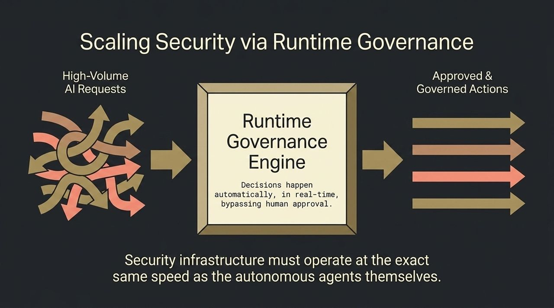
Notes:
Solution Architecture: This slide demonstrates how runtime governance resolves the human bottleneck. High-volume, high-velocity AI requests enter a Runtime Governance Engine.
Automated Decision-Making: The engine evaluates policy, intent, target, and risk in real-time, instantly outputting approved, governed actions without human intervention.
Core Takeaway: Security infrastructure must operate at the exact same speed as the autonomous agents themselves. If agents run in milliseconds, policy enforcement and access revocation must also execute in milliseconds.
Transition to Slide 11: However, automated runtime governance faces another obstacle: system fragmentation.

Slide 11
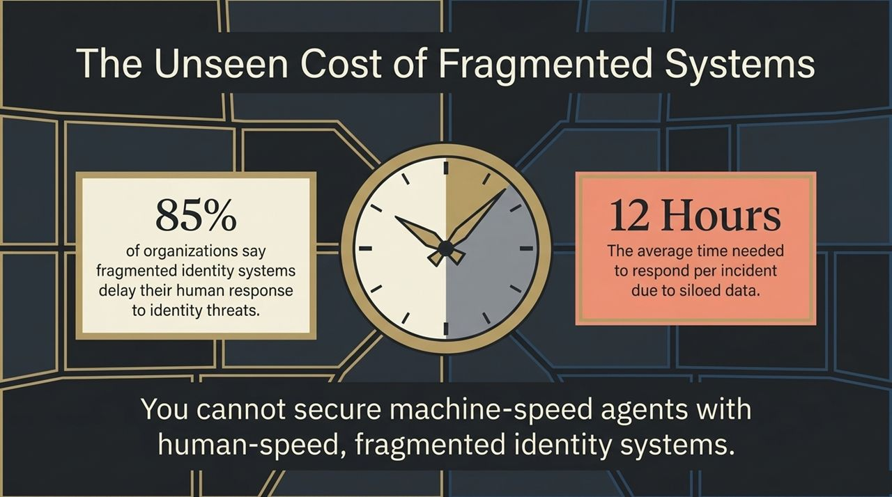
Notes:
Data Point Highlights:
85% of organizations state that fragmented identity systems significantly delay their response to identity threats.
12 Hours: The average time required to respond to a single security incident due to siloed identity data.
Analysis: If your identity data is scattered across separate HR tools, cloud IAM providers, PAM solutions, and machine-key vaults, responding to an incident takes half a day.
Bottom Line: A 12-hour response window against an autonomous agent operating at machine speed means the attacker has already completed their objective before your team finishes investigating. Fragmented identity platforms are unsustainable.
Transition to Slide 12: This friction is driving a major wave of platform consolidation across the security landscape.

Slide 12
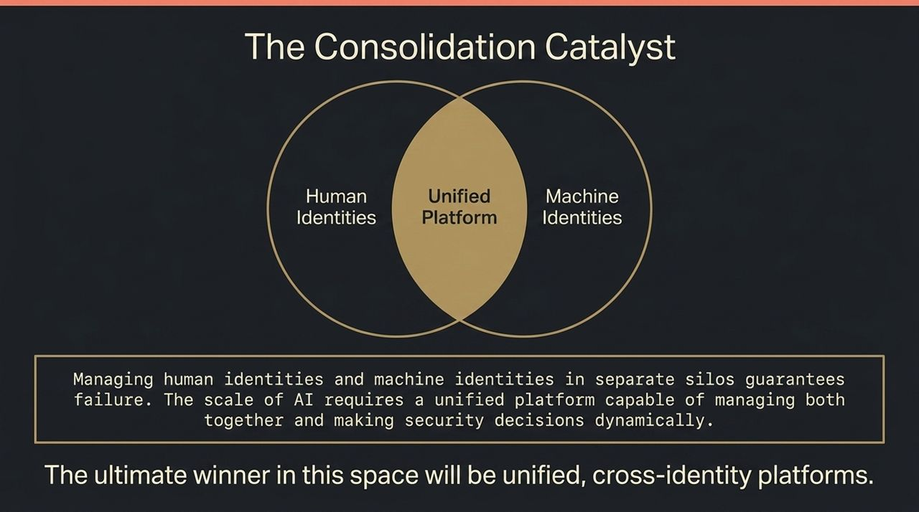
Notes:
Strategic Outlook: Managing human identities and machine identities in separate silos guarantees operational failure. The sheer scale of AI deployment forces convergence into a Unified Identity Platform.
Unified Visibility: A unified platform provides holistic visibility, governing human employees, non-human service accounts, and autonomous AI agents under a single policy engine.
Market Winner: The ultimate winners in cybersecurity will be unified, cross-identity platforms capable of evaluating contextual risk and making automated access decisions dynamically.
Transition to Slide 13: Now, let's look at what this convergence means from a market sizing perspective.

Slide 13
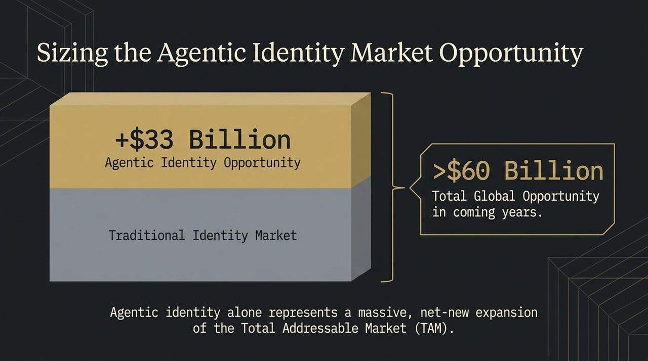
Notes:
Market Expansion Sizing: According to Morgan Stanley's cyber research, securing agentic identities represents a massive, net-new expansion of the Total Addressable Market (TAM).
Financial Breakdown:
Traditional Identity Market Base.
+$33 Billion net-new Agentic Identity TAM expansion.
>$60 Billion Total Global Identity Opportunity in the coming years.
Investor/Executive Perspective: Agentic identity isn't cannibalizing traditional identity budgets—it is expanding the total addressable market as organizations fund defenses for their non-human workforce.
Transition to Slide 14: When will this spend materialize on enterprise balance sheets? Let's review the deployment timeline.

Slide 14
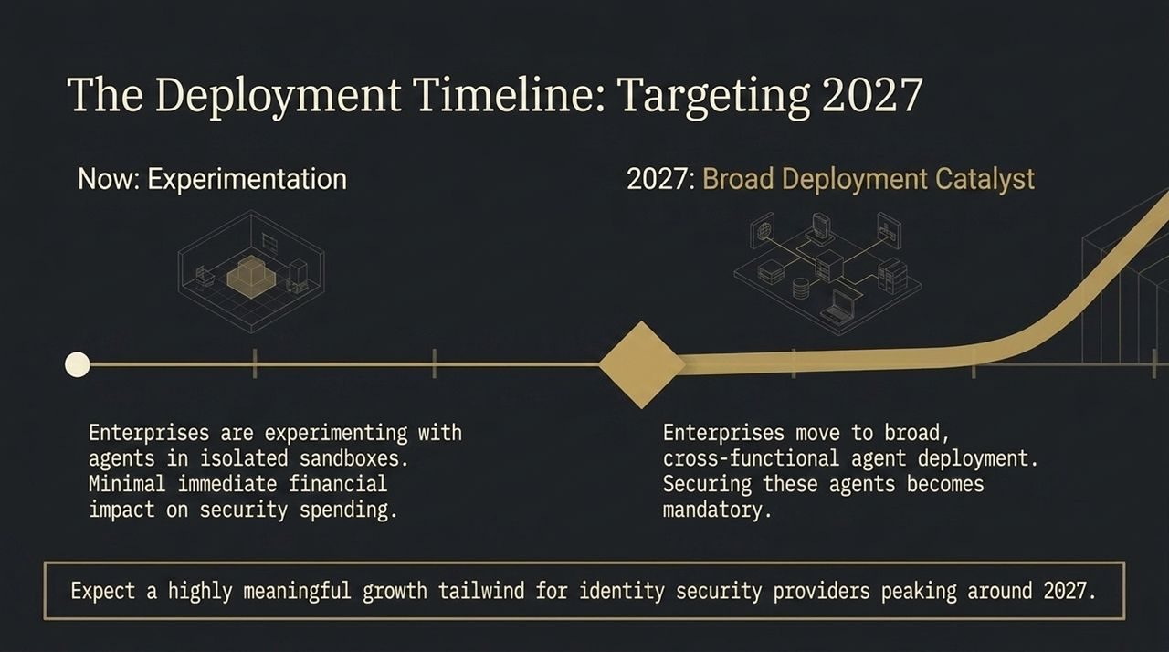
Notes:
Phase 1 (Now – Experimentation): Right now, enterprises are experimenting with AI agents in isolated sandboxes. Spending on agent security is currently minimal as these projects remain in proof-of-concept stages.
Phase 2 (2027 – Broad Deployment Catalyst): By 2027, enterprises will move from isolated sandboxes to broad, cross-functional agent deployments. At that point, securing these agents becomes mandatory for compliance and risk management.
Growth Trajectory: Expect a meaningful growth tailwind for identity security providers peaking around 2027 as production deployments ramp up.
Transition to Slide 15: This brings us to our core strategic conclusion.

Slide 15
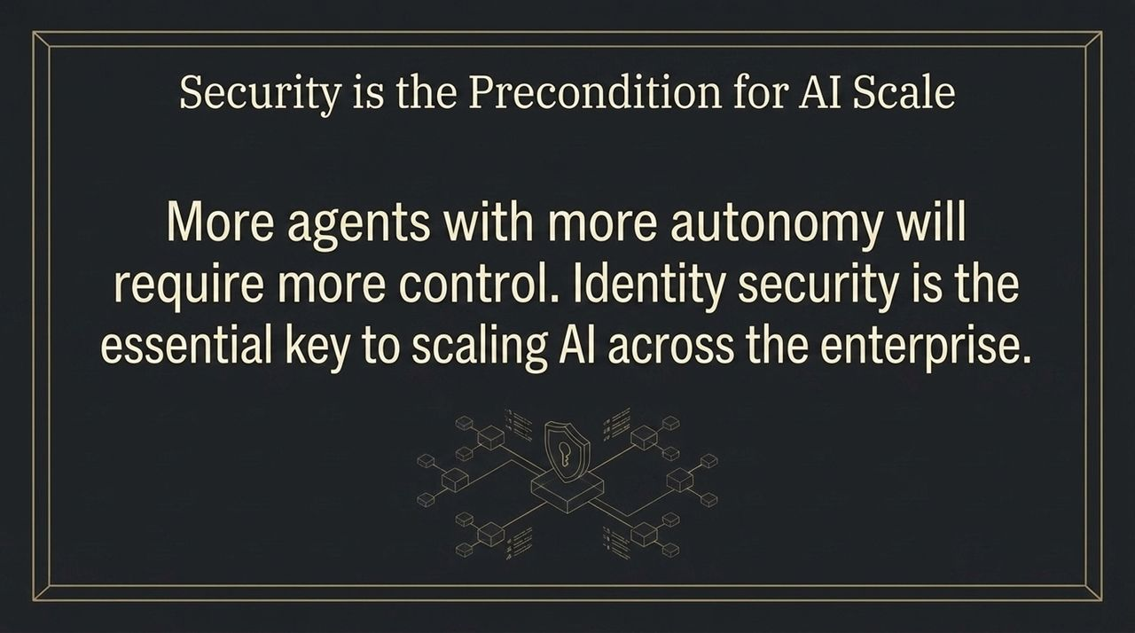
Notes:
Core Message: Organizations cannot scale what they cannot secure. Security is not a bottleneck to AI adoption; it is the ultimate enabler.
Strategic Alignment: Business leaders want to deploy autonomous agents to drive efficiency, but risk officers will halt rollouts without adequate control. More agents with higher autonomy require stricter, automated controls.
Final Strategic Takeaway: Identity security is the foundational key to scaling AI safely across the enterprise.
Transition to Slide 16: Let's summarize our entire discussion onto a single executive dashboard.

Slide 16
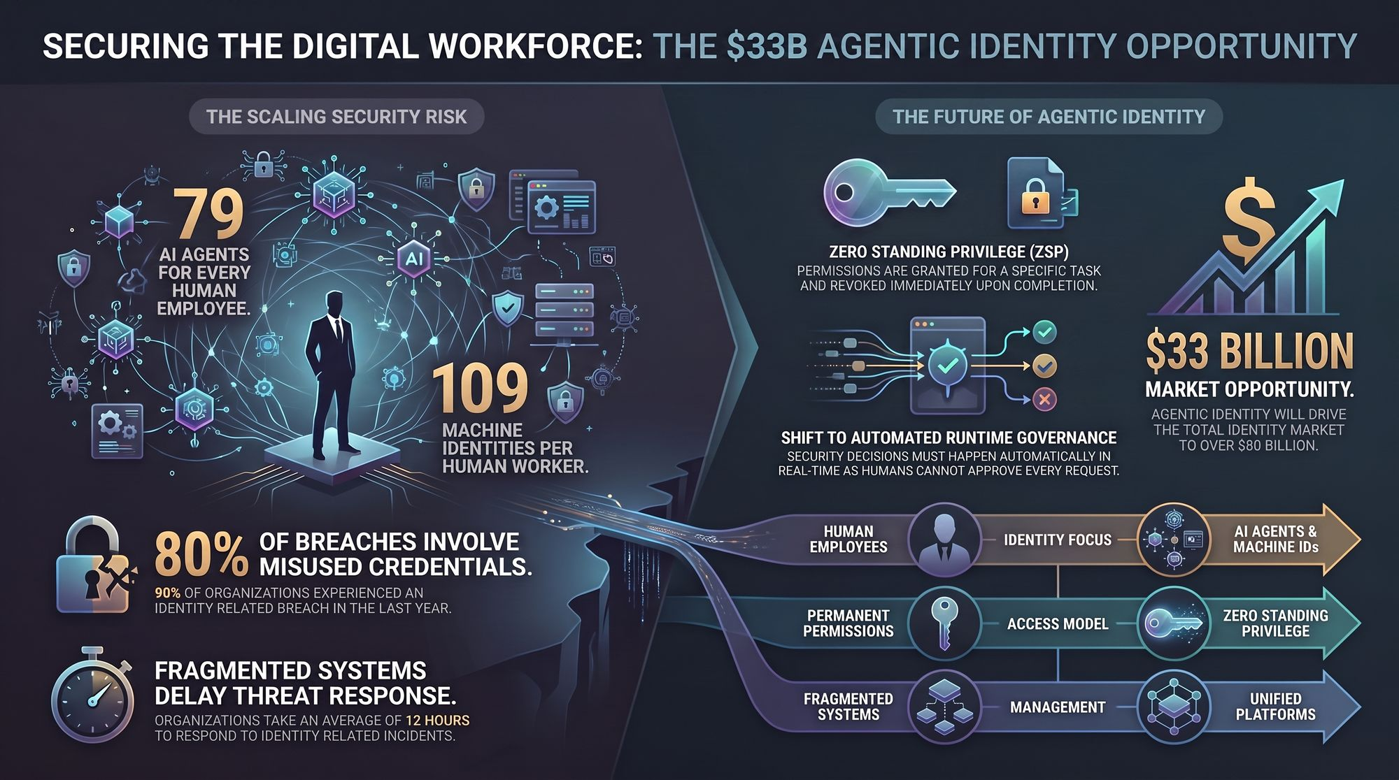
Notes:
Comprehensive Recap: To close, let me leave you with three critical pillars that summarize the $33 Billion Agentic Identity Opportunity:
The Scaling Security Risk:
79 AI Agents & 109 Machine IDs per human worker.
80% of breaches stem from credential misuse; 90% of organizations experienced an identity breach last year.
Legacy, fragmented systems take 12 hours to respond—a rate that fails against machine-speed threats.
The Future Architecture:
Transition from permanent access to Zero Standing Privilege (ZSP).
Shift from manual approvals to Automated Runtime Governance operating at sub-second speeds.
Strategic Vector Shift:
Move focus from Human Employees to AI Agents & Machine IDs.
Replace Permanent Permissions with Zero Standing Privilege.
Consolidate Fragmented Systems into Unified Platforms driving a $60B+ global market opportunity.
Q&A Transition: Thank you for your time. I am now happy to open the floor to any questions.

